Slide 1
Urban Forest Management Plan Grant Program
February 29 & March 1, 2012
Inland Urban Forest Council
Riverside, CA
Webinar One
Funded by: US Forest Service &
Cal Fire

Slide 2
Welcome!!!

Slide 3
Today’s Agenda
9:00 – 9:15 General Comments
9:15– 10:00 Why a Plan?
10:00– 10:15 Stakeholders
10:15 – 10:30 What is Next & Assignments

Slide 4
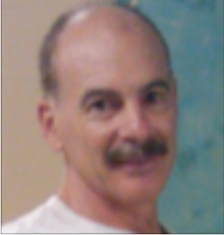
General Comments Today’s Presenter: Dave Roger

Slide 5
Project Coordinator: Nancy Sappington

Slide 6
Our 1st Webinar
Bear with us if we experience technical difficulties
Today’s protocol
Raise your hand to ask a question or
Type your question and send to project coordinator
Issues logging onto www.ufmptoolkit.com
Passwords
Today’s presentation and January’s workshop presentation will be available at www.inlandurbanforestcouncil.org
Post your comments
Confirm your site visit appointment.

Slide 7
Historic Context

Slide 8
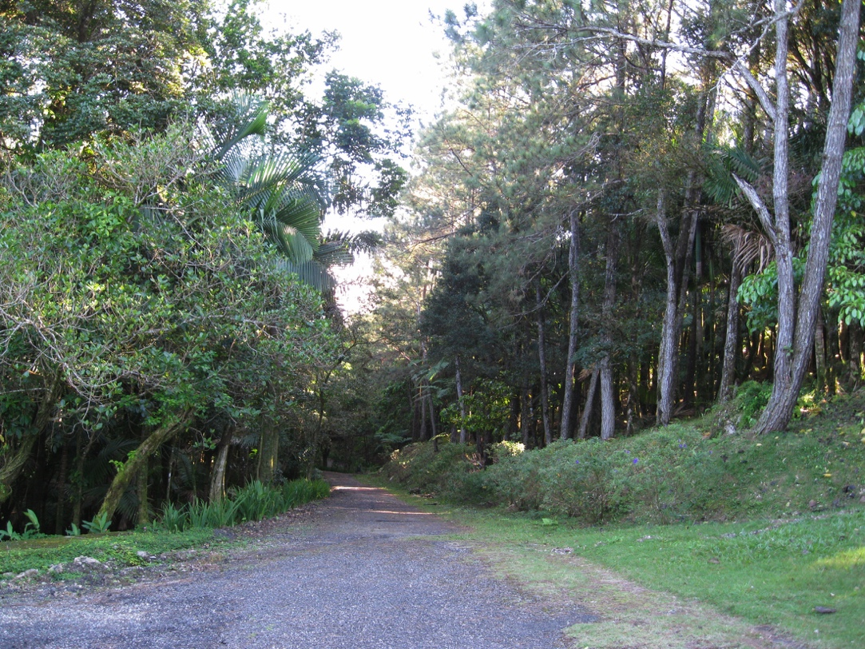
Historical Context
When were the first trees planted?
Were there any existing trees originally on the site.
If so were they
native or part of
a remnant orchard?

Slide 9
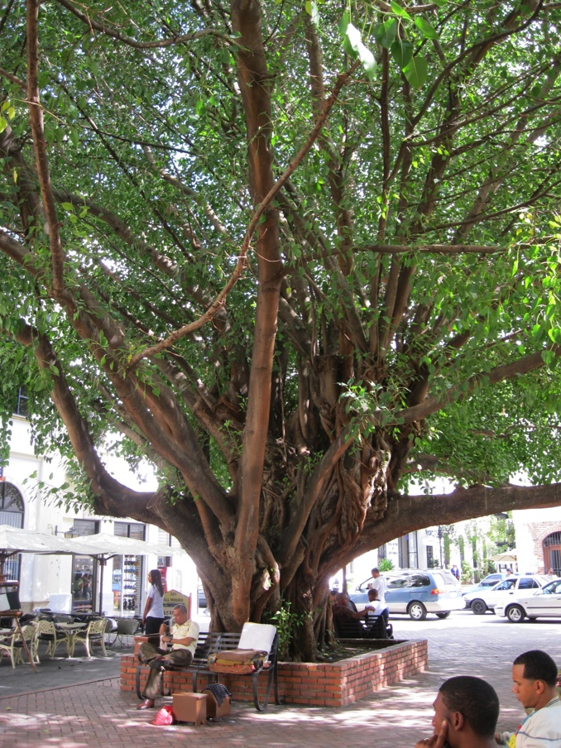
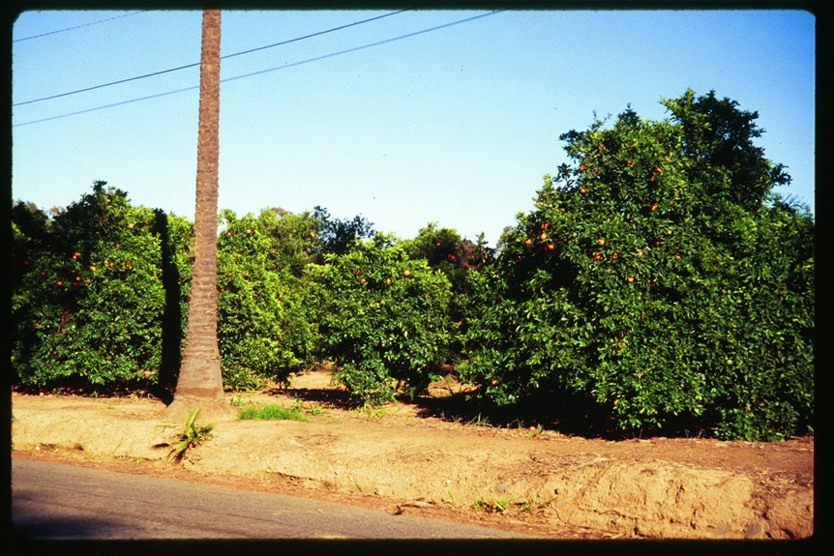
Historical Context
Why were they planted? Windbreak, Entrances
Any significance to what was planted?
Any trees with historic significance.? ie planted by someone special a
founding father for example.

Slide 10
Historical Example for Introduction
The City of Riverside, CA , founded in 1870s, has always had a strong link to trees. Much of Riverside’s history and its initial growth was influenced by the citrus industry. The early settlers planted trees along what is now historic Victoria Avenue to beautify the gateway to the citrus groves. Palm trees lined the avenue and in the parkways; they were interplanted with several varieties of eucalyptus trees, and each block of medians had a different flowering tree. To help preserve this heritage and the benefits of these trees, this management plan was initiated.

Slide 11
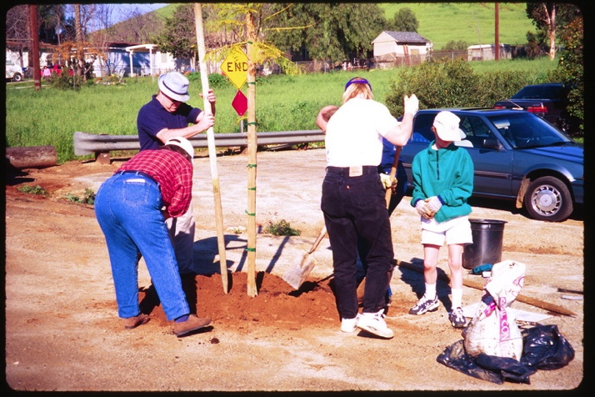
Historical Context con’t
Are/were there any community tree planting groups? When were they started? Why were they started.
Any tree board or commission? When and why was it started?
Notes:
Provide examples ie Maloofs many of the trees were relocated from a previous residence. They have historic Eucs that the city wants preserved. HOA example,

Slide 12
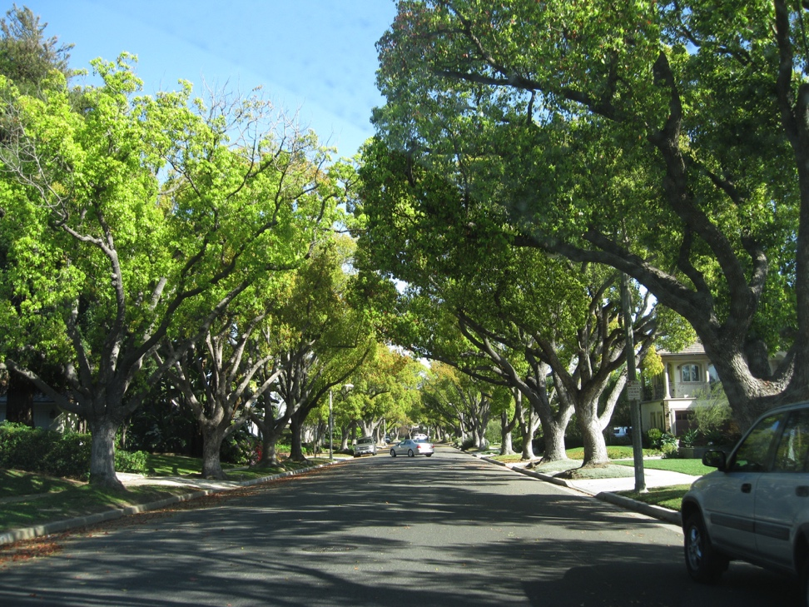
Historical Context con’t
What is the size of the tree population?
What is the age and diversity of the population?
Are there any old policies or ordinances on record and why were they put into place.

Slide 13
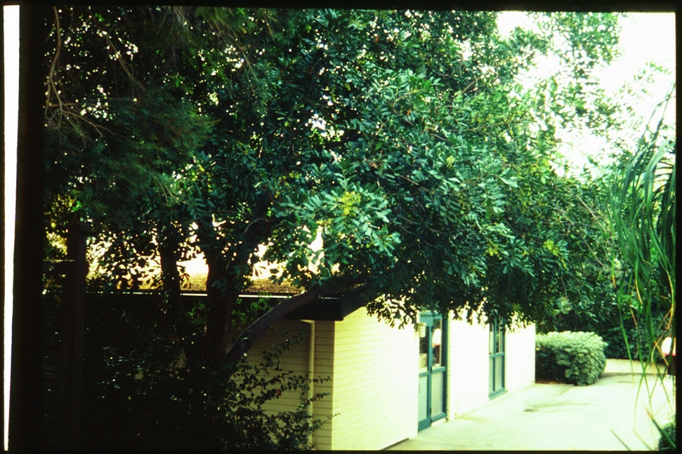
Benefit of Trees
What are the benefits of trees that are important to your community, or school, or site?
For many it is the shade value. Can you tie it into energy savings. Inland Empire communities have hot summers.

Slide 14
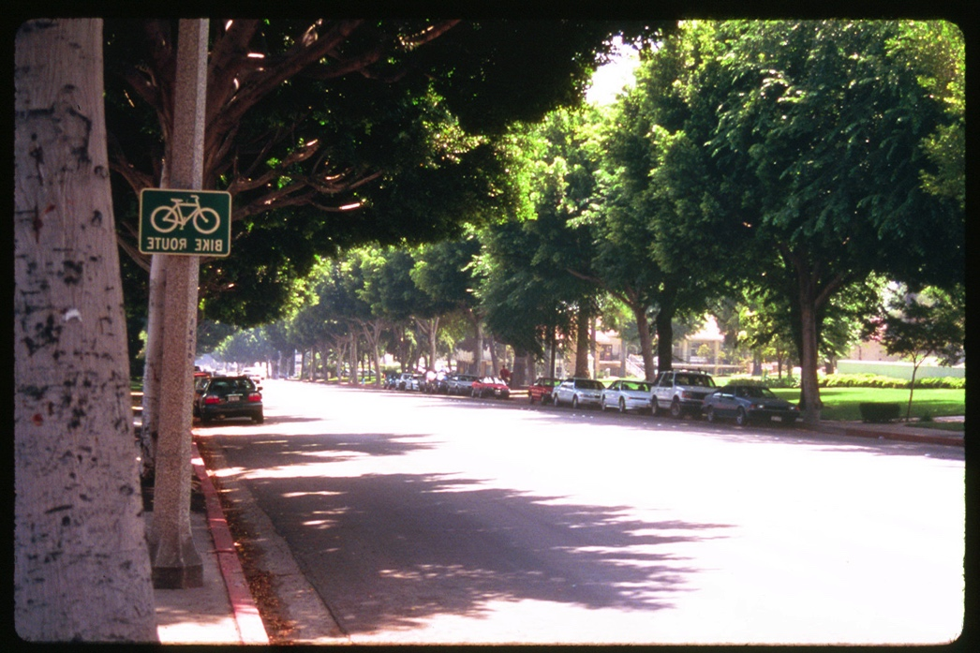
Benefits of Trees
Increase in property values. Tree lined streets are often more desirable and thus add to the value of the homes.

Slide 15
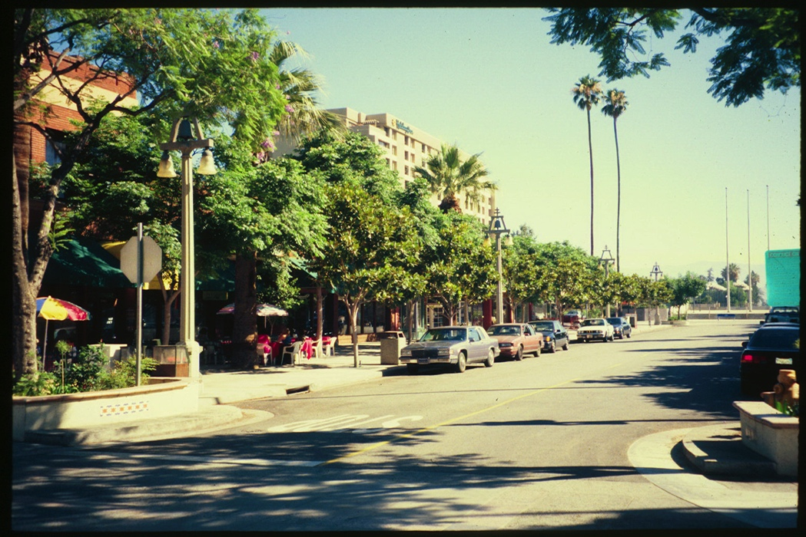
Benefit of Trees
Economic benefit. Many communities have a downtown area or a center of town that is commercial. Shaded landscaped areas in business districts have stronger sales.

Slide 16
Benefits of Trees
Is it a community with a senior population where trees have a positive impact on mental attitude?
Is it a more educated community where global warming, sustainability and the environment are of concern?

Slide 17
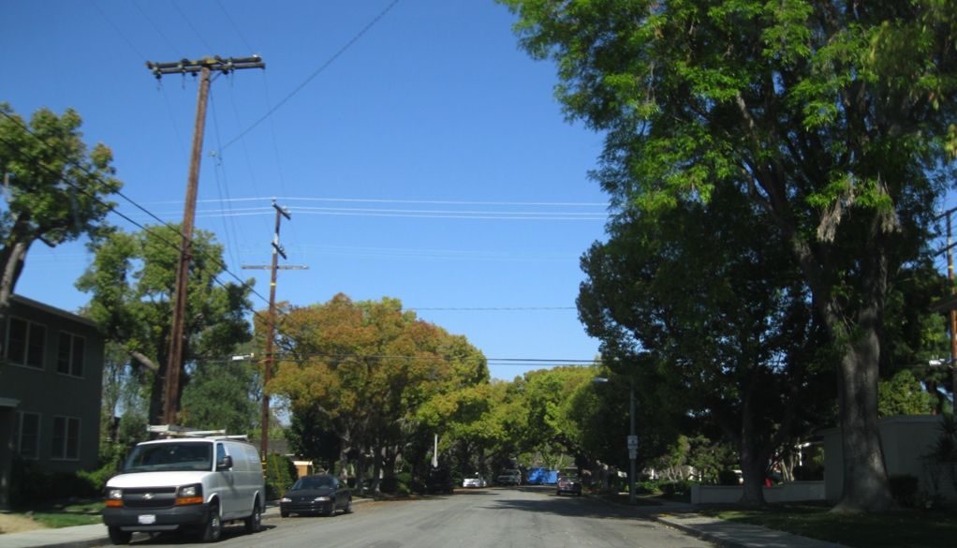
Benefits of Trees
Is your community concerned about deteriorating street surfaces and how the shade of trees helps to prolong the life of asphalt paving.

Slide 18
Benefits of Trees
Is safety an concern? Traffic calming measures where trees act as buffers in parkways between pedestrians and automobiles.

Slide 19
Benefits Example
Riverside’s urban forest contributes to the well-being of our residents in many ways. It improves air quality by pulling carbon out of the air and storing it in the form of wood in trees. Studies have shown that 100 mature trees can pull two tons of carbon from the air. Studies have also shown that trees remove up to 600 pounds of fine particulates from the air.

Slide 20
Benefits Example Con’t
The U.S. Department of Agriculture Urban Forest Research Facilities have studied a variety of trees and quality of life issues. Some of these benefits are: increased traffic safety, reduced energy usage by cooling our homes and saving up to 23 percent on air conditioning costs, and increased property values. Trees contribute to an increase in sociological benefits such as:
increased student performance at shaded schools
improved recovery time where trees are visible from windows at hospitals
reduced domestic violence at tree-lined housing developments

Slide 21
Benefits Example Con’t
Studies have also shown that people prefer to shop where there are trees and landscaping. According to USDA, a large tree in Riverside will provide approximately $3,880 in environmental benefits during its lifetime. That is more than a 300 percent return on investment.

Slide 22
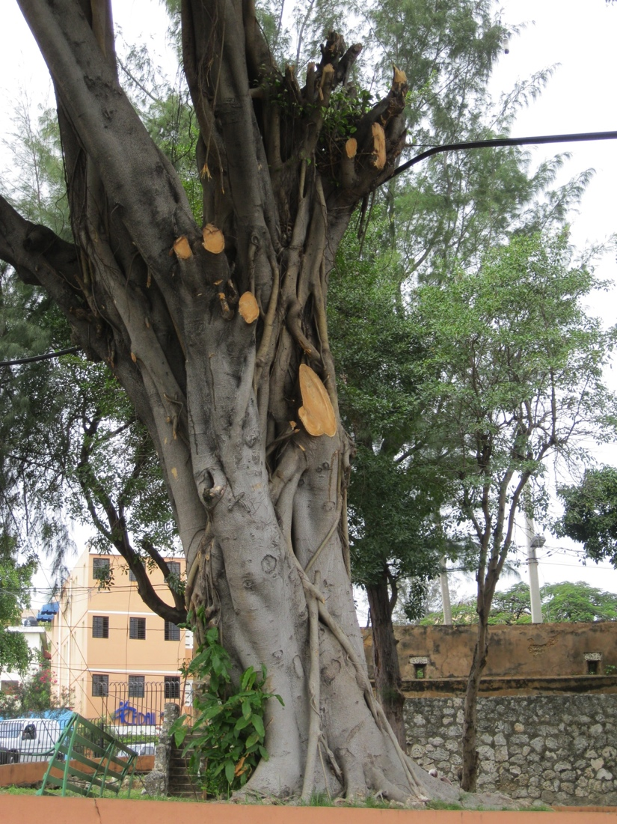
What is in the plan!
What do you have?
Inventory
Concerns and Issues from the inventory and others.
Policies
Best Management Practices

Slide 23
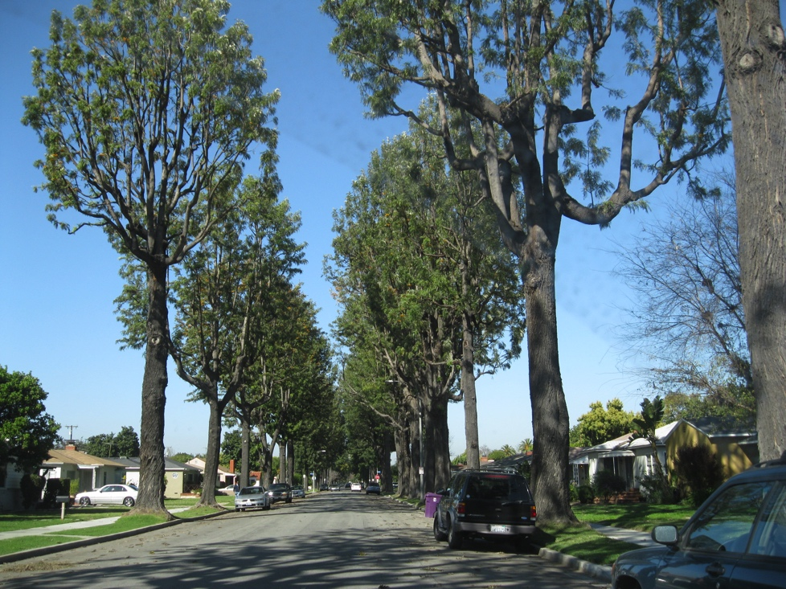
What do you want?
What is the vision for the community?
Canopy Cover
Healthy Trees
Minimal Hardscape Damage
Species and Age Diversity

Slide 24
How are you going to get there?
Setting Goals and Objectives
Tree Removal and Replacement Program
Historic Tree Preservation

Slide 25
Getting There
Trees in conflict with wires, sidewalks, curbs & gutters and streets.
Tree Protection Zones
for developments.

Slide 26
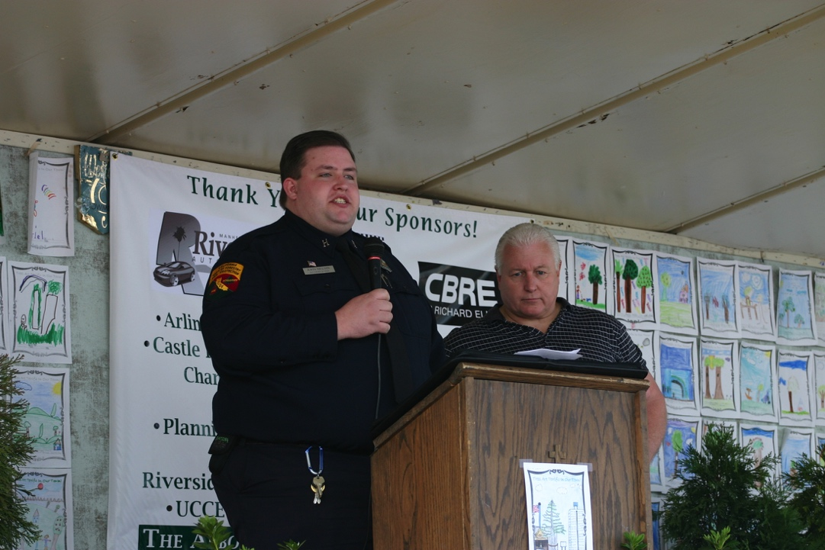
Funding and Budgeting
Where will monies come from to preserve, protect and provide for a healthy Urban Forest.
Mitigation Measures
Fines and Fees
Assessment Districts
Etc.

Slide 27
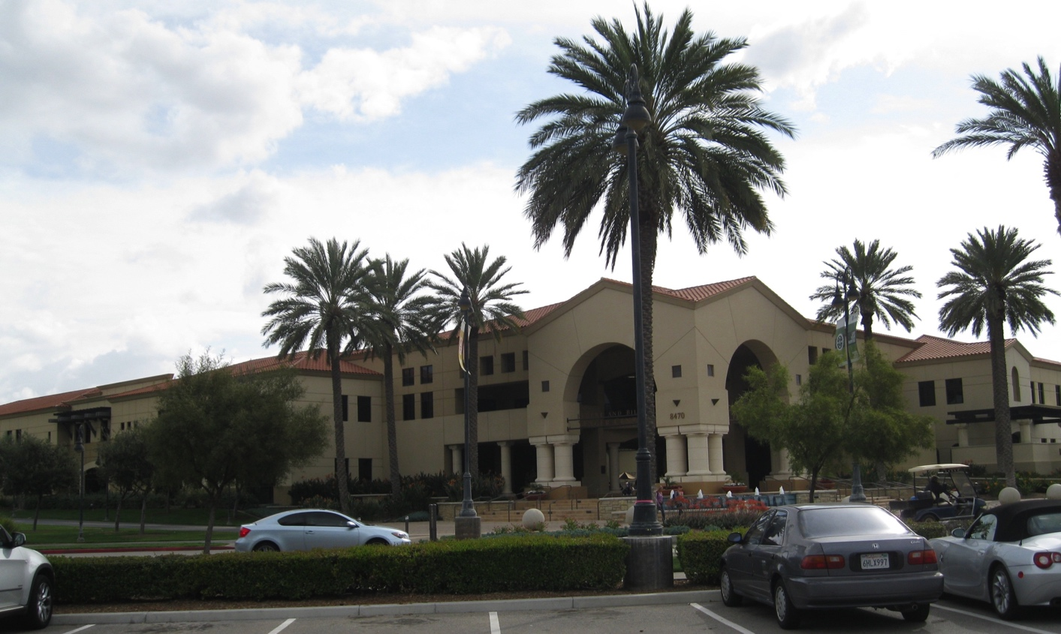
Are you getting what you want?
Establishing a Monitoring System so that all stakeholders are kept informed of the progress of the plan.

Slide 28
Example
Riverside has an aging population of trees. Some are more than 50 years old and eventually will need to be removed and replaced. The tree industry knows more now than it did 50 years ago about what trees do best in our semi-arid Mediterranean climate. Proper tree selection and placement is vital to our future.

Slide 29
Example
This plan discusses the makeup of our tree population. It looks at the health of our trees and addresses the questions: is this the right tree in the right place; is there adequate species diversity; and how can we improve age diversity with our aging population of trees.

Slide 30
Example
This plan is essential in guiding the city toward a healthy sustainable urban forest. This plan looks at what we currently have, the issues at hand, recommends a course of action based on achievable goals, details how we will achieve these goals, and includes a monitoring system to see how we are doing.

Slide 31
Stakeholders
Elected Officials: Mayor, City Council, Board of Supervisors, Board of Education, etc.
Appointed Officials: City Boards and Commissions, Advisory Boards or Councils
Top Management: City Managers or Administrator, Executive Director, School Superintendent, etc.

Slide 32
Stakeholders
Departments: Planning, Public Works, Engineering, Streets, Legal, Risk Management, Utilities, Sanitation, Parks, Recreation, etc.
Staff: Department Heads, Superintendents, Supervisors, Crew Leaders, Field Workers, Volunteer Leaders, Volunteers
Influential Individuals: Community Leaders, Influential Business Leaders, Chambers of Commerce, Service Clubs (Lions, Kiwanis, Rotary etc), Garden Clubs, Beautification Groups like Keep America Beautiful Organizations, Tree and Landscape Contractors.

Slide 33
What is Next & Assignments
Your assignment
Incorporate your responses from the January assignment into your UFMP Introduction sections.
Do this by March 9.
We will review and give individual feedback.
Next in-person workshops
Riverside – March 21
San Rafael – March 22
We will be working on Section 6, ‘The Status of the Urban Forest.’
You will be assigned to a team.
We are here to help. Please let us know your concerns.

